Slide 1
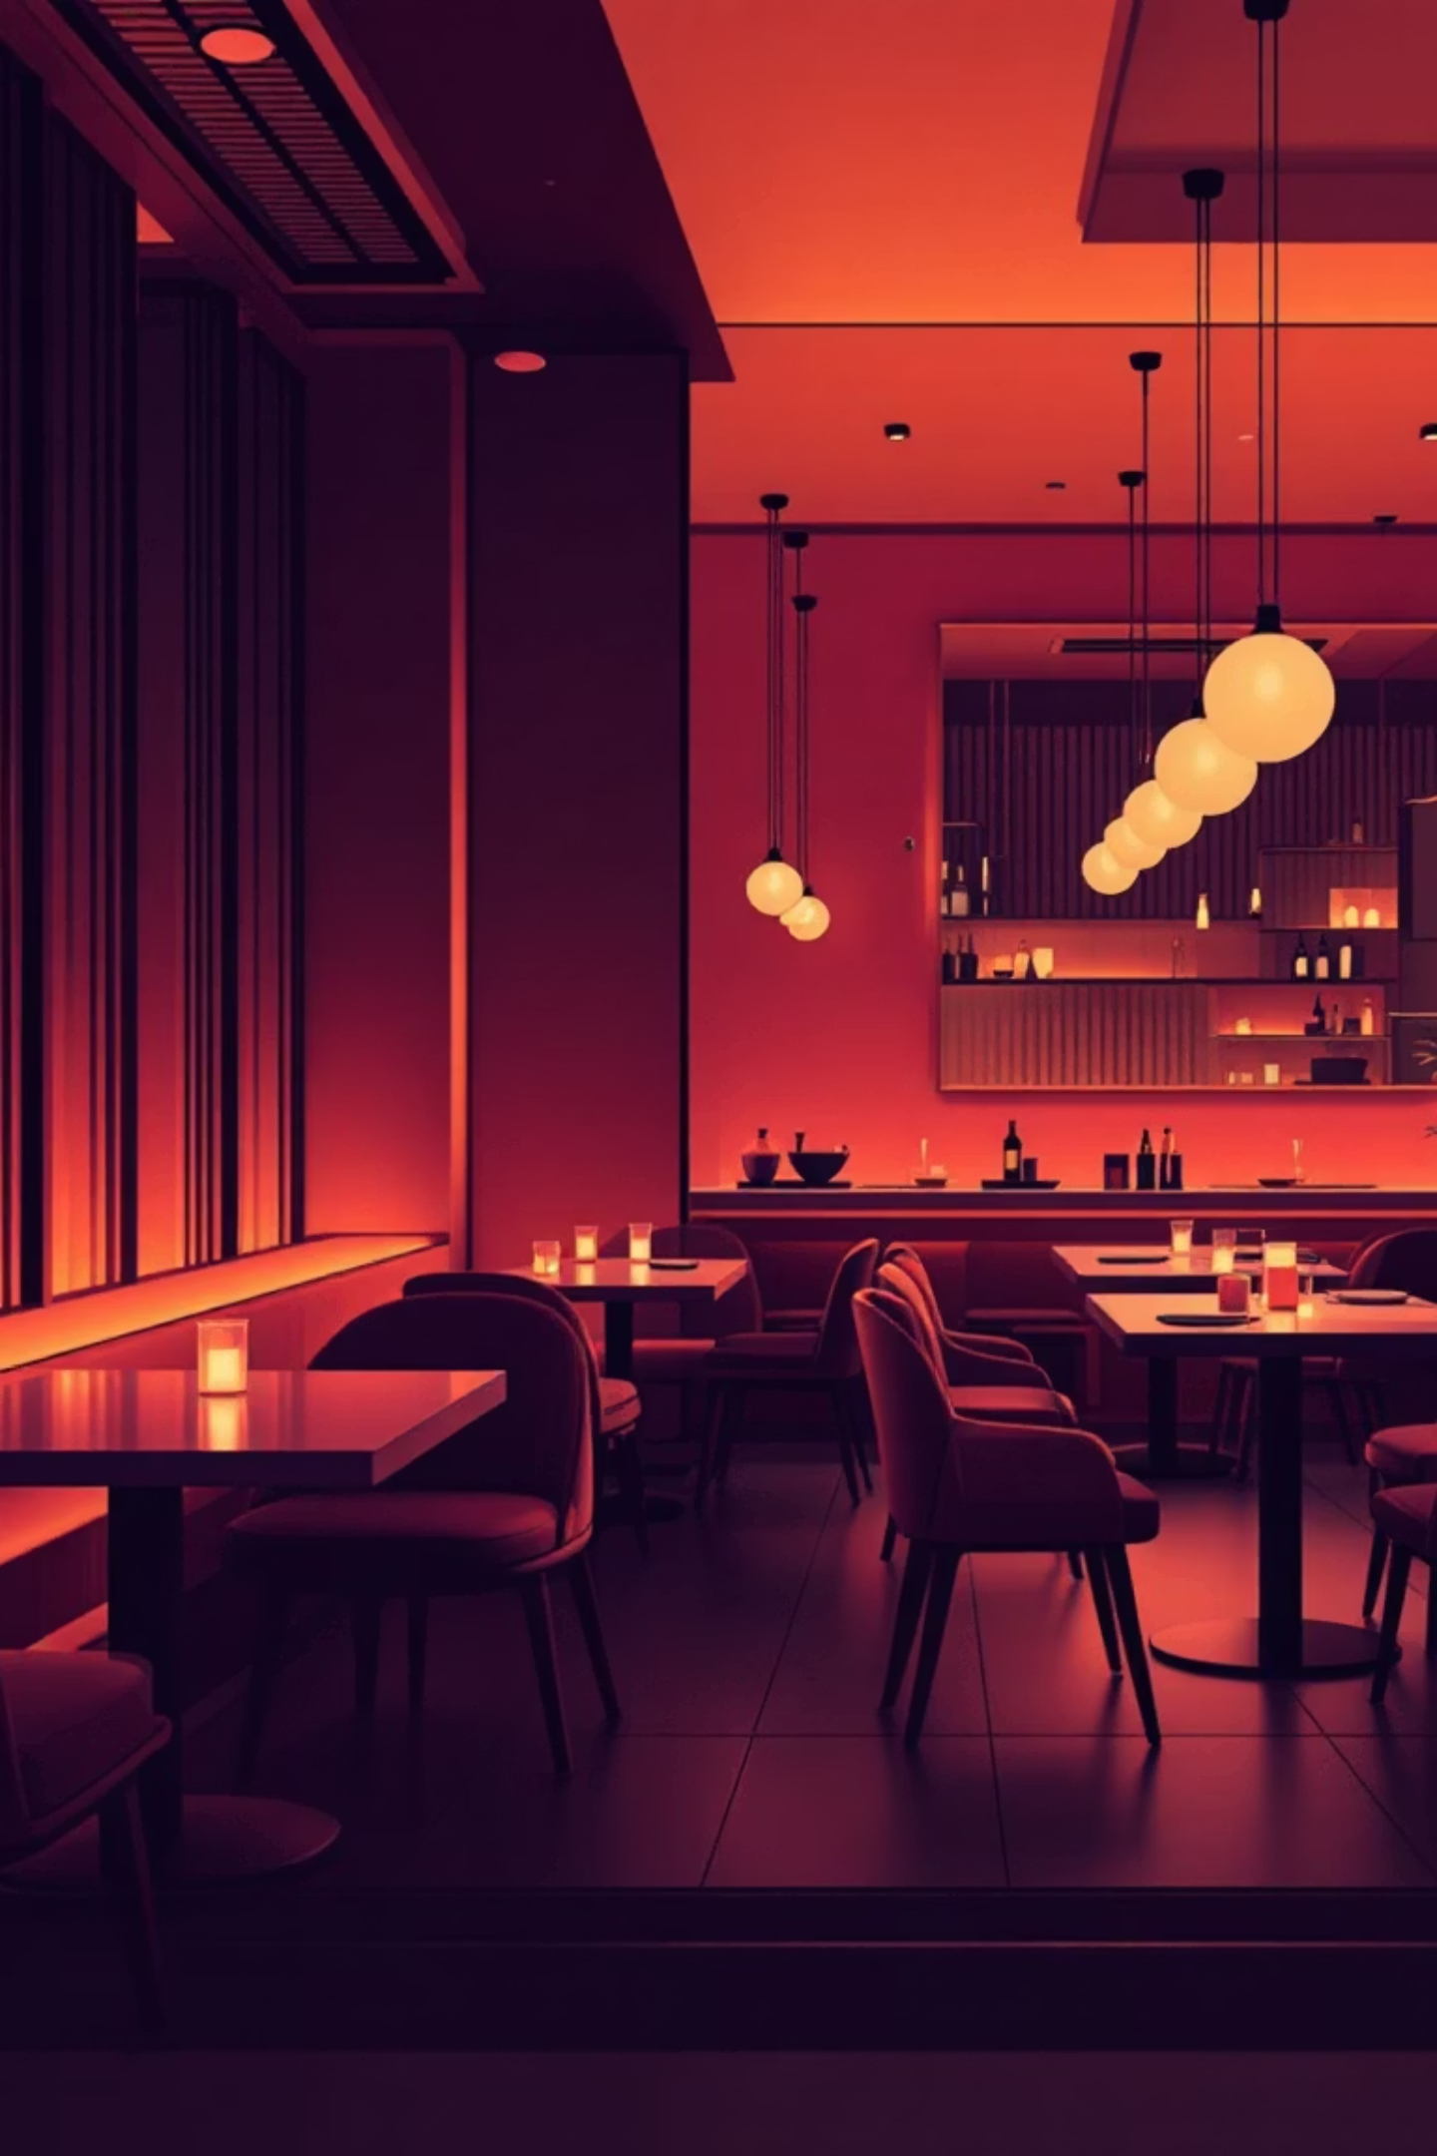


Flavour Loft: A Culinary Journey
Presented by: Taru Sharma
Branch: CSE E
UID: 202501100200336
Presented to: Dr. Nand Kishor

Slide 2






Crafting a Digital Dining Experience
Homepage & Brand Identity
Introduction & Concept
Structured Culinary Menu
Establishing a memorable first impression with the restaurant’s name and logo, setting the stage for the culinary journey.
A dedicated page explaining Flavour Loft's unique theme, innovative concept, and the highlights that make it a distinctive dining destination.
A beautifully organized menu with categorized food items, making it easy for guests to explore our diverse offerings.
Seamless Online Reservations
Contact & Feedback
A user-friendly system allowing visitors to book tables conveniently, ensuring a smooth and hassle-free experience.
Providing all necessary contact details for inquiries, feedback, and special requests, fostering direct communication with our patrons.

Slide 3
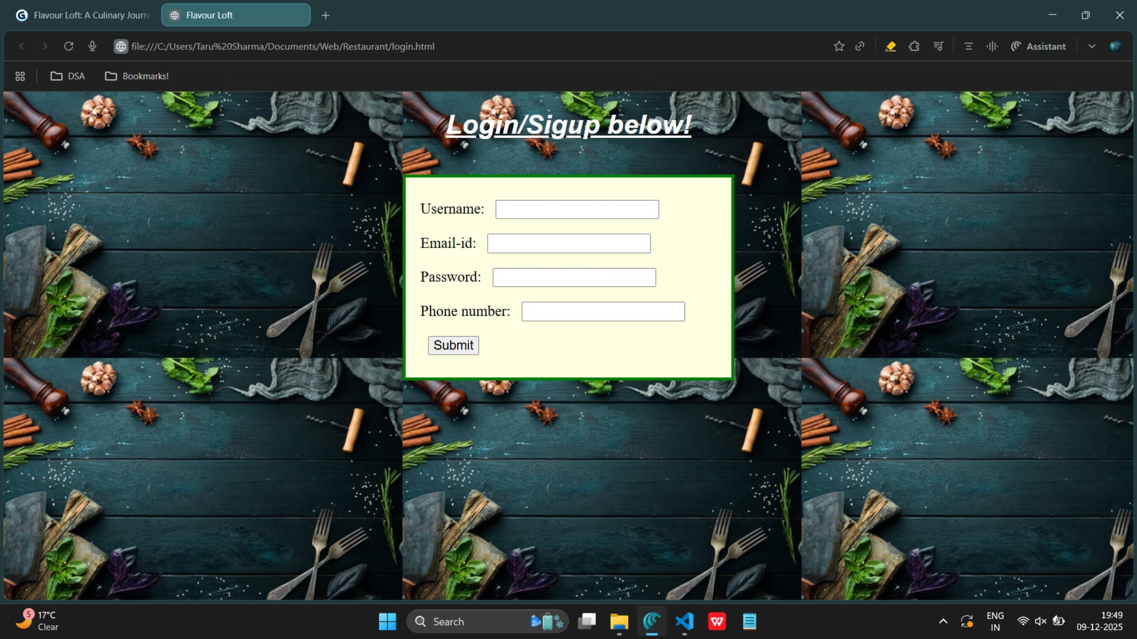

Slide 4
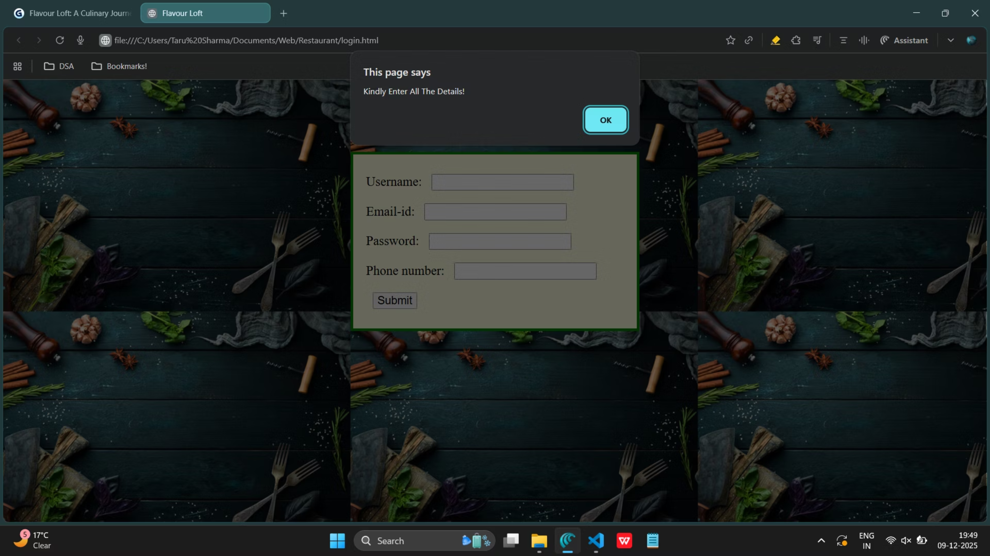

Slide 5
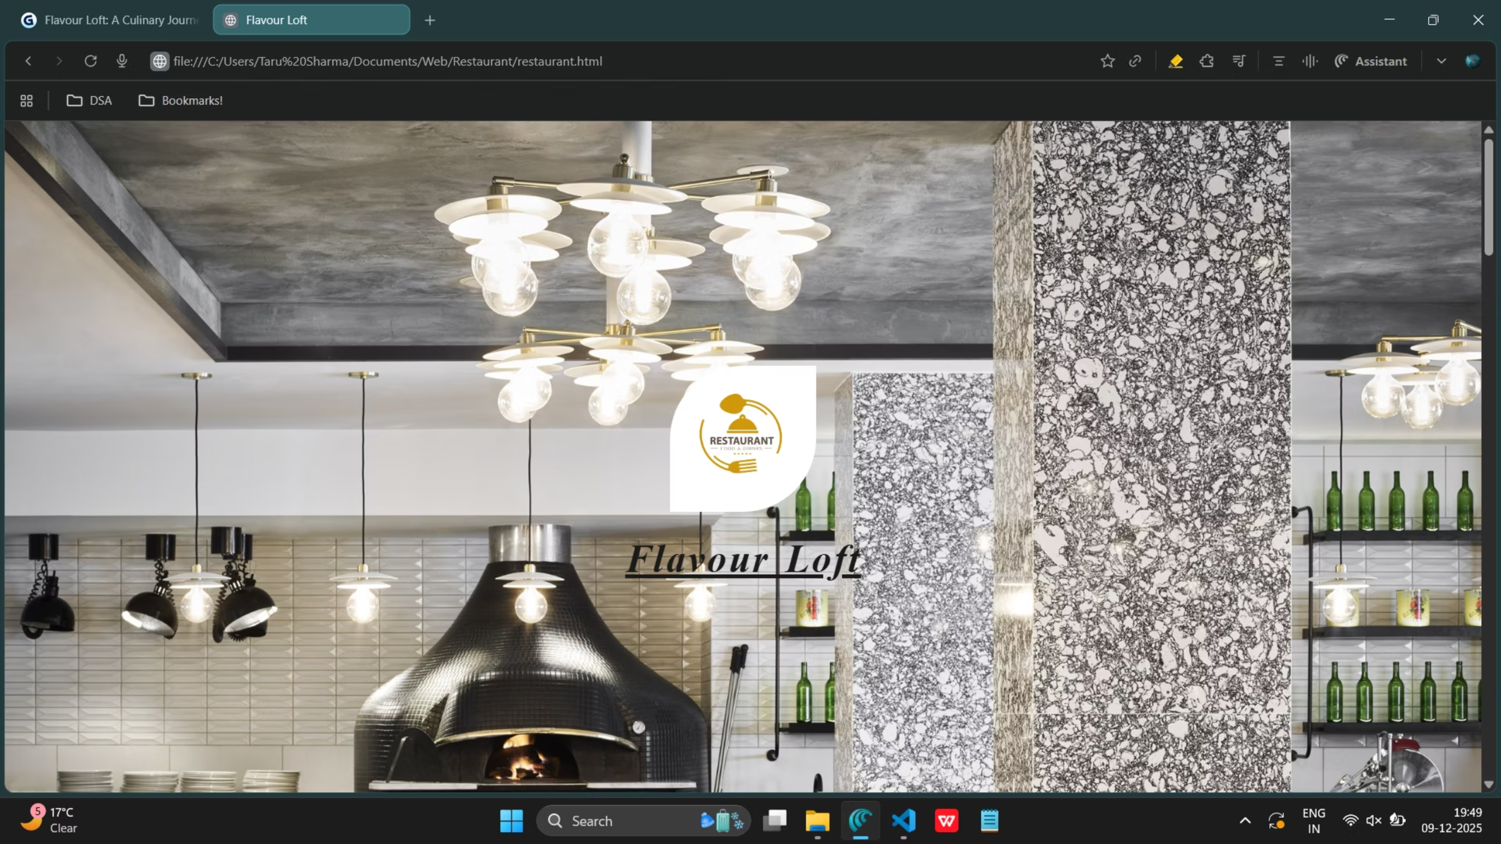

Slide 6
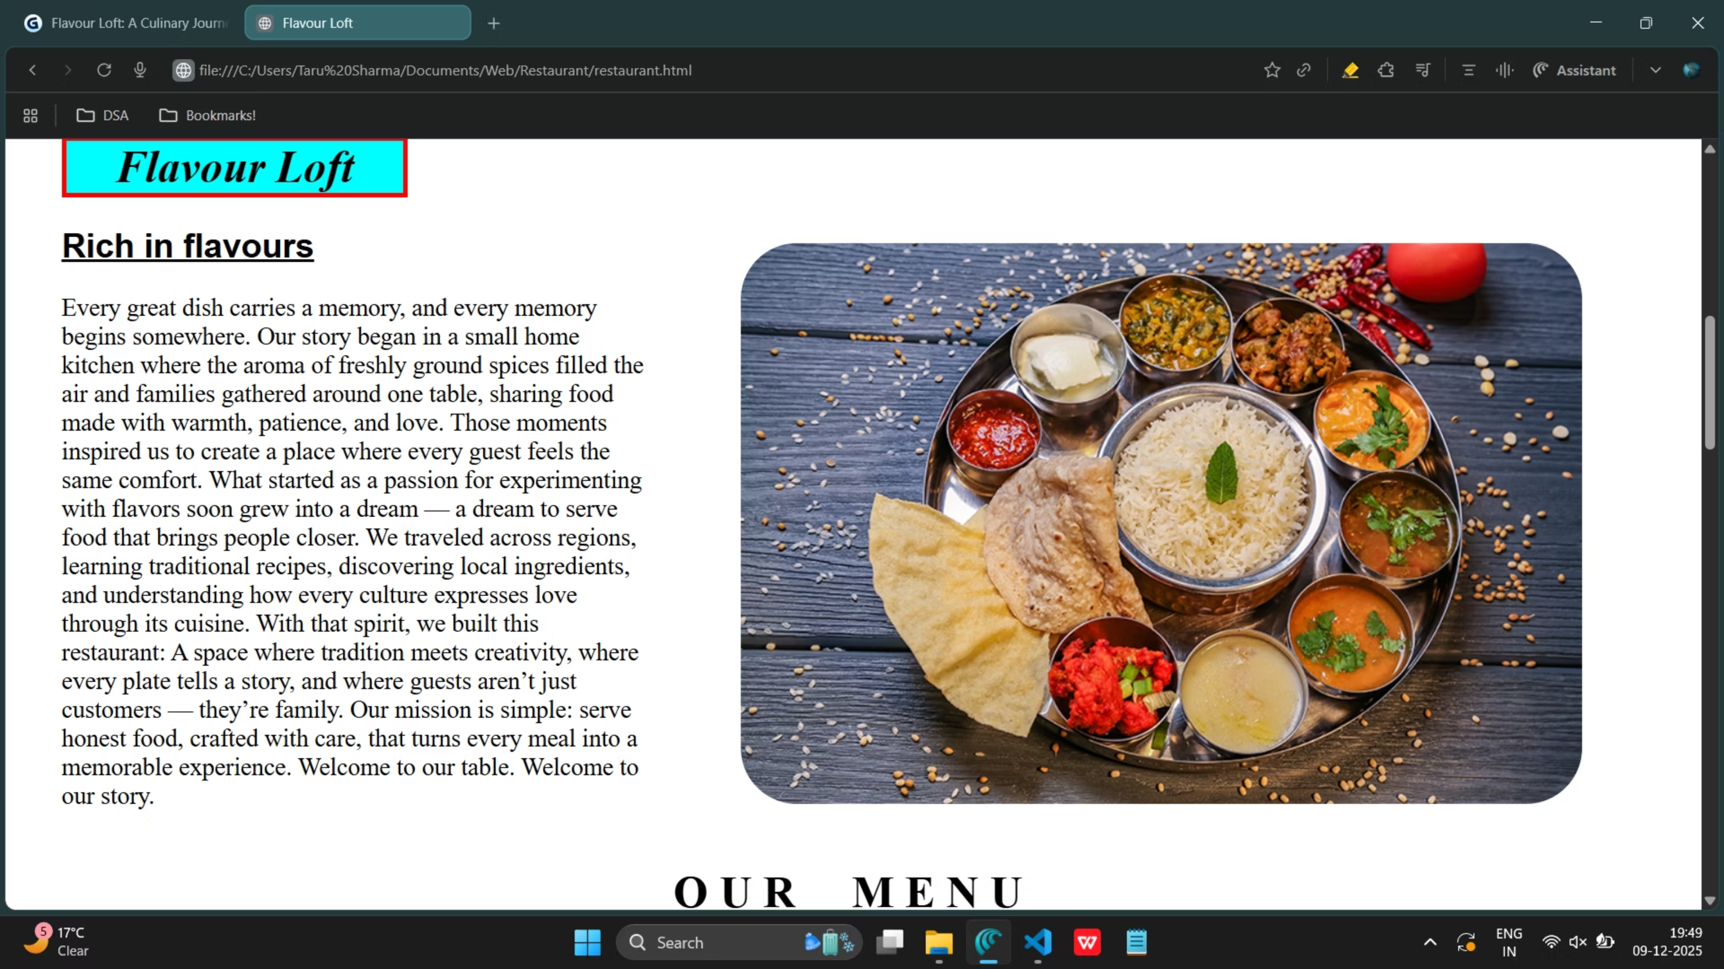

Slide 7
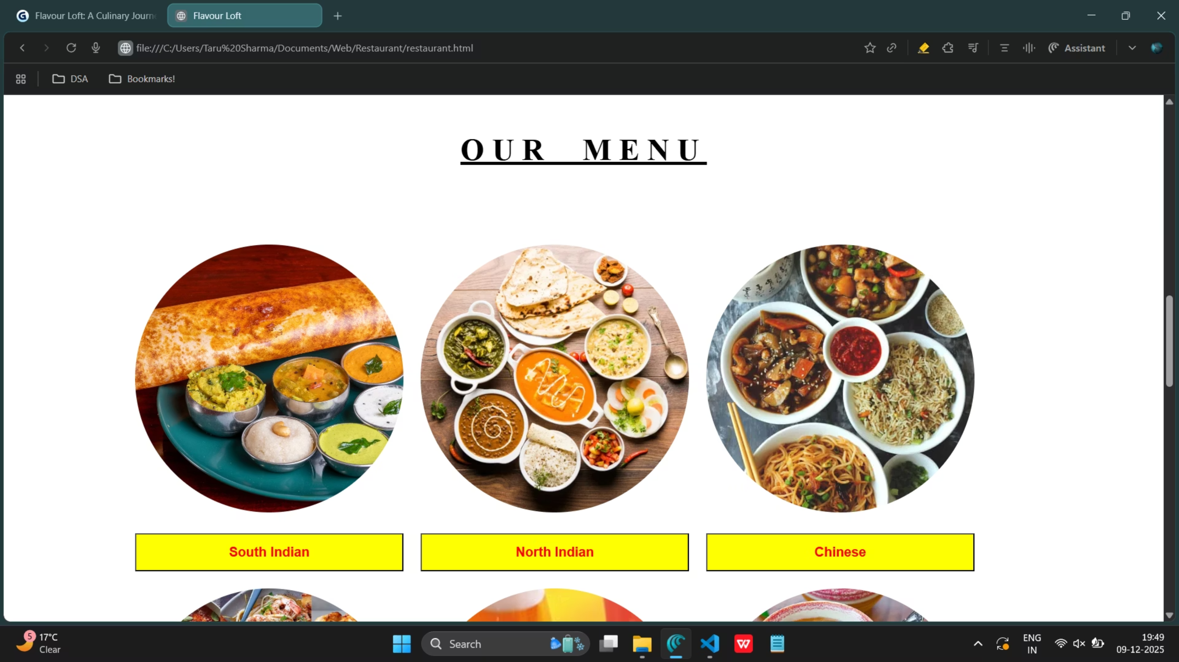

Slide 8
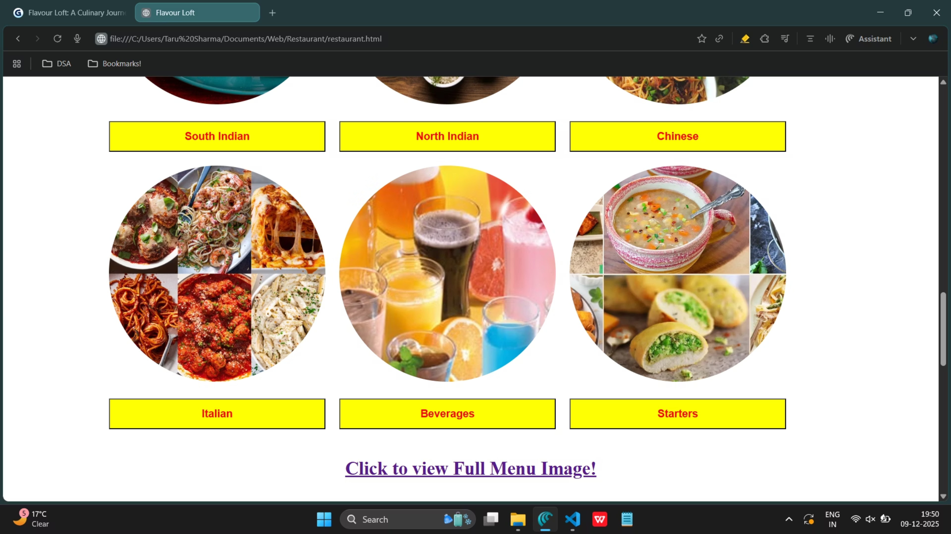

Slide 9
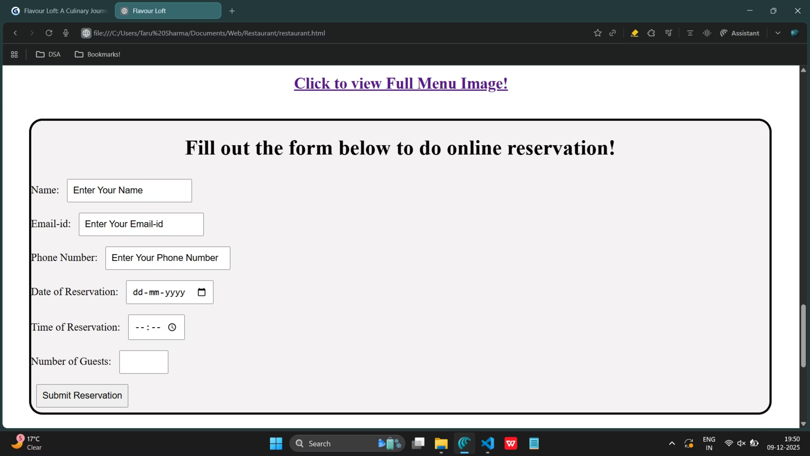

Slide 10
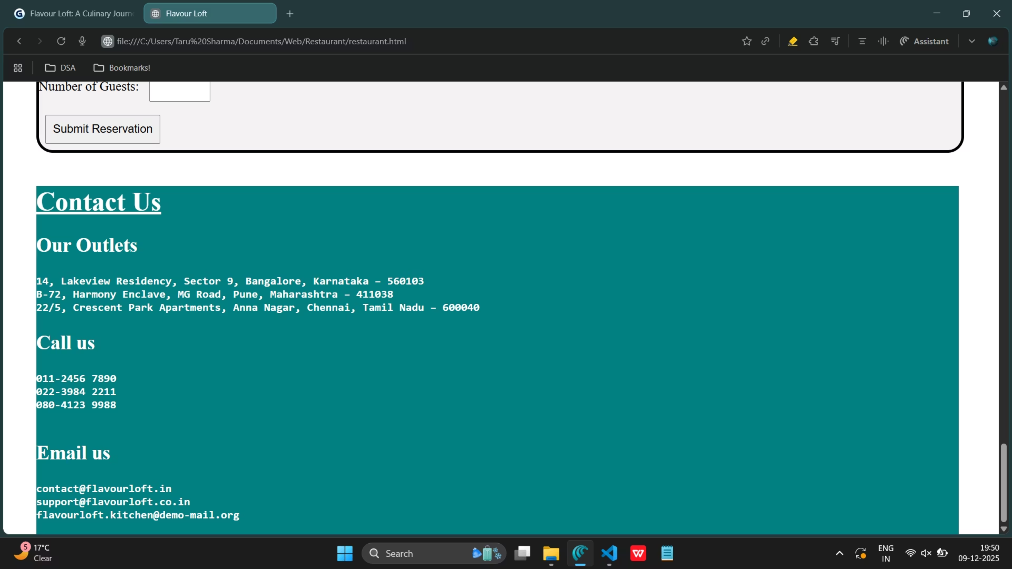

Slide 11
login.html
<!doctype html>
<html lang="en">
<head>
<title>Flavour Loft</title>
<link rel="stylesheet" href="styles.css">
<script language="JavaScript">
function restaurant(){
let username,email,pass,phno;
username=document.myForm.fname.value;
email=document.myForm.email_address.value;
pass=document.myForm.password.value;
phno=document.myForm.phone_number.value;
if(username=="" || email=="" || pass=="" || phno==""){
alert("Kindly Enter All The Details!");
}
else{
window.open("restaurant.html", "_self");
}
}
</script>
</head>
<body>
<h1><em><u>Login/Sigup below!</u></em></h1><br>
<form class="commonAlignment" name="myForm">
Username: <input type="text" name="fname" width="100"><br>
Email-id: <input type="email" name="email_address" width="100"><br>
Password: <input type="password" name="password" width="100"><br>
Phone number: <input type="telephone" name="phone_number" width="100"><br>
<input type="button" value="Submit" onclick="restaurant();">
</form>
</body>
</html>

Slide 12
styles.css
.commonAlignment input{ margin: 10px; } body{ background-image: url('bg_login.jpg'); } h1{ color: rgb(255, 255, 255); font-family: Arial, sans-serif; font-size: 36px; text-align: center; } form{ border: 4px solid green; padding: 20px; margin: auto; width: 400px; background-color: lightyellow; }

Slide 13
restaurant.html
<!doctype html>
<html lang="en">
<head>
<title>
Flavour Loft
</title>
<link rel="stylesheet" href="restaurant_style.css">
</head>
<body>
<center>
<img src="restaurant_logo.jpg" id="logo">
</center>
<h1 class="main_heading"><em><u> Flavour Loft</u></em></h1>
<div class="second_webpage">
<h1 id="heading"><em>Flavour Loft</em></h1>
<h2 style="font-family:arial;"><u>Rich in flavours</u></h2>
<p style="font-size:22px; margin-right:80px;">
Every great dish carries a memory, and every memory begins somewhere.
Our story began in a small home kitchen where the aroma of freshly ground spices filled the air and families gathered around one table, sharing food made with warmth, patience, and love. Those moments inspired us to create a place where every guest feels the same comfort.
What started as a passion for experimenting with flavors soon grew into a dream — a dream to serve food that brings people closer. We traveled across regions, learning traditional recipes, discovering local ingredients, and understanding how every culture expresses love through its cuisine.
With that spirit, we built this restaurant:
A space where tradition meets creativity, where every plate tells a story, and where guests aren’t just customers — they’re family.
Our mission is simple: serve honest food, crafted with care, that turns every meal into a memorable experience.
Welcome to our table.
Welcome to our story.
</p>
</div>
<img src="food.webp" style="border-radius:50px 50px 50px 50px;">
<h1 id="menu"><strong><u>OUR MENU</u></strong></h1>
<table cellspacing="20px">
<tr>
<td><img src="south indian.jpg" class="tableimg"></td>
<td><img src="north indian.webp" class="tableimg"></td>
<td><img src="chinese.jpg" class="tableimg"></td>
</tr>
<tr>
<td><button style="width:350px; height:50px; background-color:yellow; color:red;"><strong>South Indian</strong></button></td>
<td><button style="width:350px; height:50px; background-color:yellow; color:red;"><strong>North Indian</strong></button></td>
<td><button style="width:350px; height:50px; background-color:yellow; color:red;"><strong>Chinese</strong></button></td>
</tr>
<tr>
<td><img src="italian.jpg" class="tableimg"></td>
<td><img src="beverages.jpg" class="tableimg"></td>
<td><img src="starters.webp" class="tableimg"></td>
</tr>
<tr>
<td><button style="width:350px; height:50px; background-color:yellow; color:red;"><strong>Italian</strong></button></td>
<td><button style="width:350px; height:50px; background-color:yellow; color:red;"><strong>Beverages</strong></button></td>
<td><button style="width:350px; height:50px; background-color:yellow; color:red;"><strong>Starters</strong></button></td>
</tr>
</table>
<center>
<h2><a href="full_menu.png" target="_blank">Click to view Full Menu Image!</a></h2>
</center>
<div class="reservationForm">
<center><h1>Fill out the form below to do online reservation!</h1></center>
<form class="commonAlignment" name="myForm">
Name: <input type="text" name="name" value="Enter Your Name"><br>
Email-id: <input type="email" name="email" value="Enter Your Email-id"><br>
Phone Number: <input type="telephone" name="phone" value="Enter Your Phone Number"><br>
Date of Reservation: <input type="date" name="date"><br>
Time of Reservation: <input type="time" name="time"><br>
Number of Guests: <input type="number" name="guests" min="1" max="20"><br>
<input type="submit" value="Submit Reservation">
</form>

Slide 14
</div>
<div class="last_webpage">
<h1><u>Contact Us</u></h1>
<h2>Our Outlets</h2>
<p>
<h4>
<pre>
14, Lakeview Residency, Sector 9, Bangalore, Karnataka – 560103
B-72, Harmony Enclave, MG Road, Pune, Maharashtra – 411038
22/5, Crescent Park Apartments, Anna Nagar, Chennai, Tamil Nadu – 600040
</pre>
</h4>
</p>
<h2>Call us</h2>
<p>
<h4>
<pre>
011-2456 7890
022-3984 2211
080-4123 9988
</pre>
</h4>
</p>
<h2>Email us</h2>
<p>
<h4>
<pre>
contact@flavourloft.in
support@flavourloft.co.in
flavourloft.kitchen@demo-mail.org
</pre>
</h4>
</p>
</div>
</body>
</html>

Slide 15
restaurant_style.css
body{
background-image: url('restaurant_bg.jpg');
background-size: cover;
background-repeat:no-repeat;
height:100vh;
margin:0;
}
#logo{
width:150px;
height:150px;
margin-top:250px;
border-radius: 75px 0 75px 0;
}
.main_heading{
margin:20px 0 300px 0;
letter-spacing:2px;
word-spacing:5px;
color:#1A1A1A;
text-align:center;
}
.second_webpage{
display:inline-block;
width:600px;
height:600px;
margin-left:50px;
}
#heading{
border:4px solid red;
background-color:cyan;
width:300px;
text-align:center;
}
#menu{
letter-spacing:10px;
word-spacing:20px;
text-align:center;
margin-top:50px;
}
table{
display:block;
margin:80px 150px 0 150px;
}
.tableimg{
width:350px;
height:350px;
object-fit:cover;
border-radius:175px;
}
.last_webpage{
display:block;
background-color:teal;
color: rgb(255, 255, 255);
margin:50px 0 0 50px;
width:1400px;
}
.reservationForm{
border:4px solid;
width:1400px;
margin:50px 0 50px 50px;
background-color:rgb(244, 242, 242);
border-radius:25px;
}
.commonAlignment input{
margin:10px;
padding:10px;
}

Slide 16
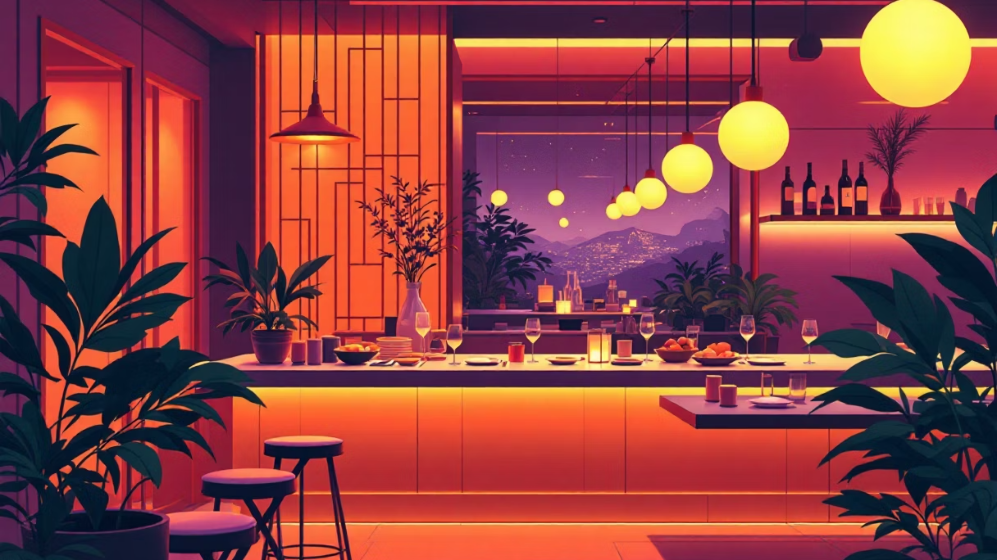
Thank You!

